Slide 1

Geometry
Unit 4, Lesson 1 Algebraic Descriptions for Translations and Rotations Volume 1, pg. 177

Slide 2


Benchmark
MA.912.GR.2.1
Given a preimage and image, describe the transformation and represent the transformation algebraically using coordinates.
volume 1, pg. 177

Slide 3
Integrated Mathematical Thinking and Reasoning Standards
MA.K12.MTR.1.1 Actively participate in effortful learning both individually and collectively.
MA.K12.MTR.2.1 Demonstrate understanding by representing problems in multiple ways.
MA.K12.MTR.3.1 Complete tasks with mathematical fluency.
MA.K12.MTR.5.1 Use patterns and structure to help understand and connect mathematical concepts.
MA.K12.MTR.6.1 Assess the reasonableness of solutions.
volume 1, pg. 177

Slide 4

Learning Targets
I can relate a translation on the coordinate plane to an algebraic notation of the transformation.
I can relate a rotation about the origin on the coordinate plane to an algebraic notation of the transformation.
volume 1, pg. 177

Slide 5

Warm-Up
volume 1, pg. 177

Slide 6

4.1.1 Warm-Up: A Career in Pharmacy
A career as a pharmacist is just one of many jobs in the health care field. Pharmacists need an understanding of both science and mathematics. Pharmacists also need to work with patients on their prescriptions to ensure the medication is working as it should.
What is one thing you learned about pharmacists that you did not know?
How does paying attention to detail help you to learn mathematics?
volume 1, pg. 177

Slide 7

Collaboration
volume 1, pg. 178

Slide 8

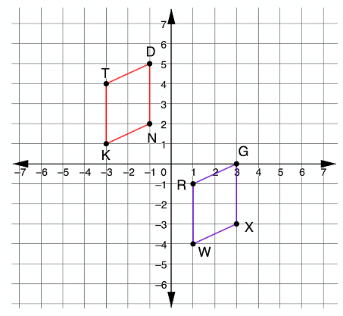
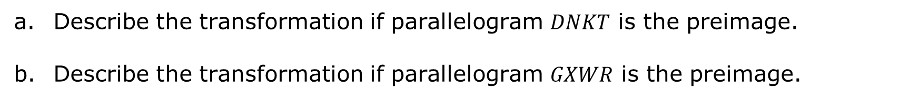
4.1.2 Collaboration: Discovering Algebraic Descriptions for Translations
Parallelograms $DNKT$ and $GXWR$ are shown on the coordinate grid.
Describe the transformation if parallelogram $DNKT$ is the preimage.
Describe the transformation if parallelogram $GXWR$ is the preimage.
volume 1, pg. 178

Slide 9
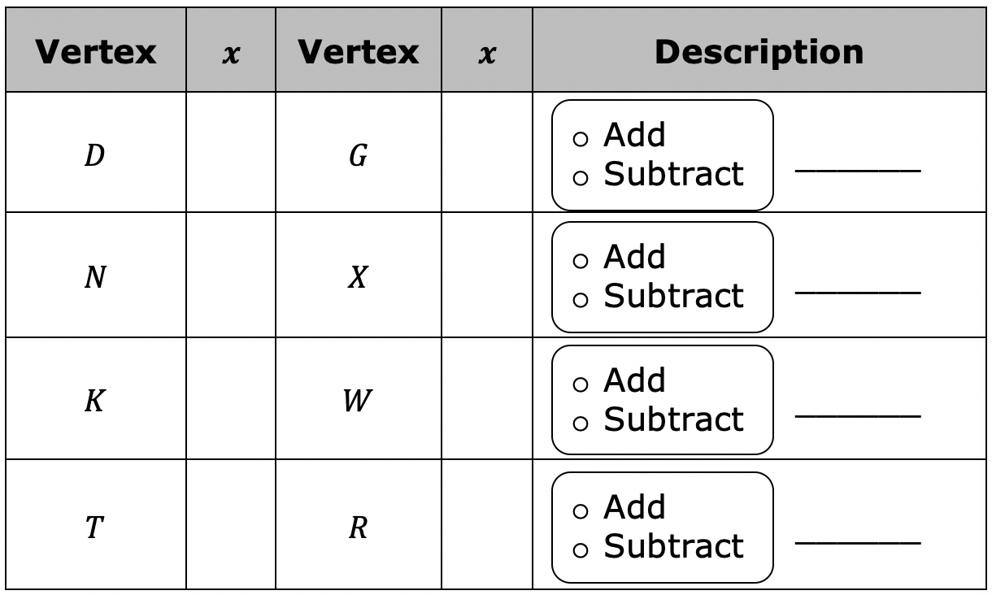
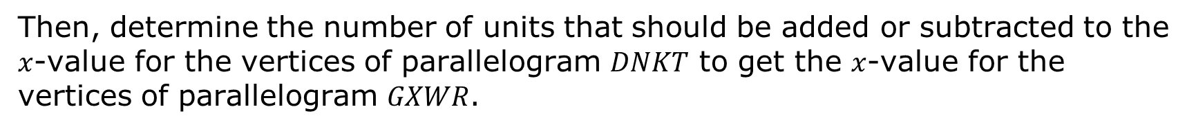
Complete the table by writing the $x$-value of each vertex in the columns provided.
Then, determine the number of units that should be added or subtracted to the $x$-value for the vertices of parallelogram $DNKT$ to get the $x$-value for the vertices of parallelogram $GXWR$.
volume 1, pg. 178

Slide 10
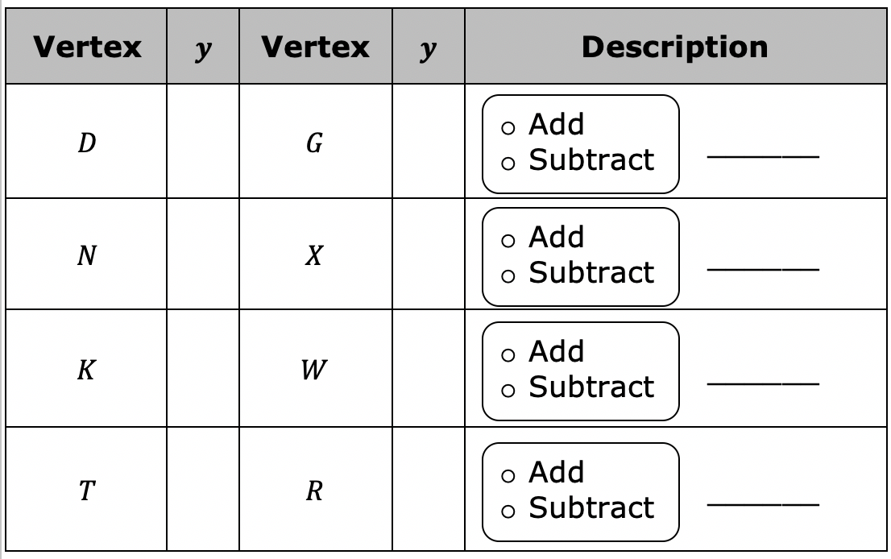
Complete the table by writing the $y$-value of each vertex in the columns provided.
Then, determine the number of units that should be added or subtracted to the $x$-value for the vertices of parallelogram $DNKT$ to get the $x$-value for the vertices of parallelogram $GXWR$.
volume 1, pg. 179

Slide 11

Transformations can be described using words, as well as using a notation.
Use the tables to complete the algebraic description of the transformation if parallelogram $DNKT$ is the preimage.
Discuss with your partner how the algebraic description of the transformation would change if parallelogram $GXWR$ is the preimage.
volume 1, pg. 179

Slide 12
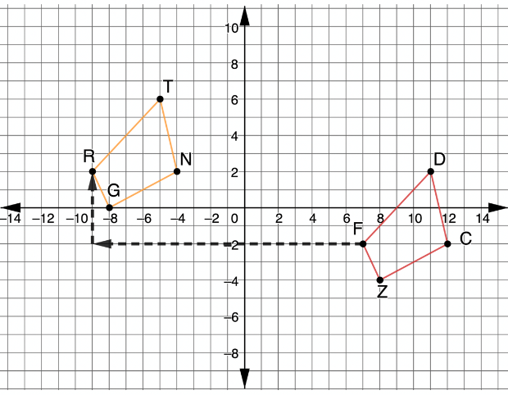
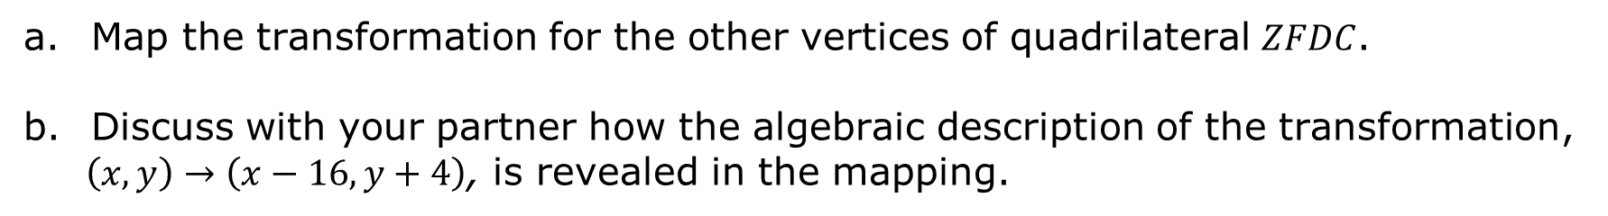
Quadrilaterals $GRTN$ and $ZFDC$ are shown on the coordinate grid. A mapping of vertex $F$ is shown.
Map the transformation for the other vertices of quadrilateral $ZFDC$.
Discuss with your partner how the algebraic description of the transformation,
$\left(x,y\right)→\left(x−16,y+4\right)$, is revealed in the mapping.
volume 1, pg. 179

Slide 13
Collaboration
volume 1, pg. 180

Slide 14
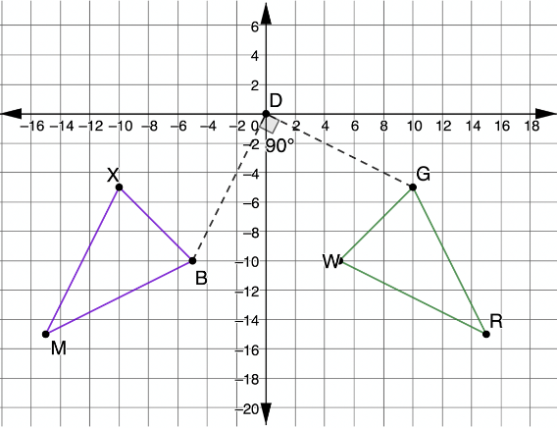
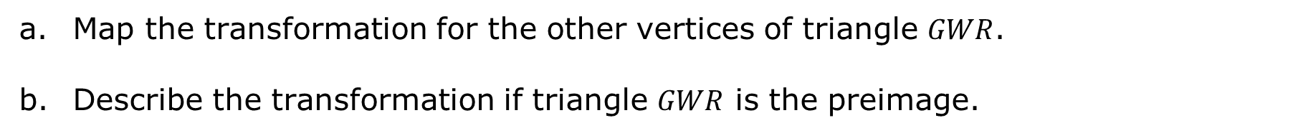
4.1.3. Collaboration: Discovering Algebraic Descriptions for Rotations
Triangles $BXM$ and $GWR$ are shown on the coordinate grid, where $∆GWR$ is the preimage. A mapping of vertex $G$ is shown.
Map the transformation for the other vertices of triangle $GWR$.
Describe the transformation if triangle $GWR$ is the preimage.
volume 1, pg. 180

Slide 15

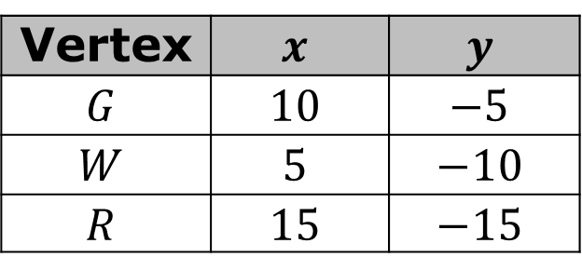
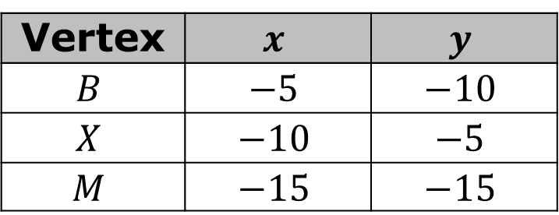


Discuss with your partner how to use the table of values to describe the relationship of the corresponding vertices using an algebraic description.
Triangle $GWR$
Triangle $BXM$
Vertex | $$x$$ | $$y$$
$$G$$ | $$10$$ | $$−5$$
$$W$$ | $$5$$ | $$−10$$
$$R$$ | $$15$$ | $$−15$$
Vertex | $$x$$ | $$y$$
$$B$$ | $$−5$$ | $$−10$$
$$X$$ | $$−10$$ | $$−5$$
$$M$$ | $$−15$$ | $$−15$$
Write a conjecture that you and your partner think will work for the algebraic description of the rotation.
volume 1, pg. 180

Slide 16
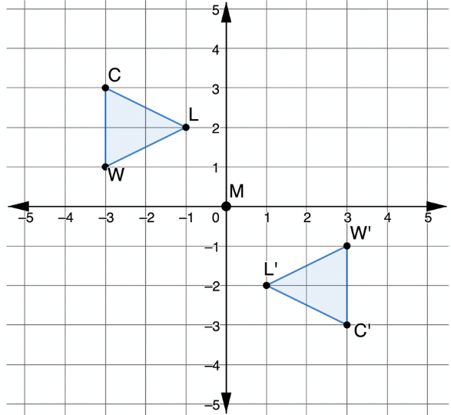

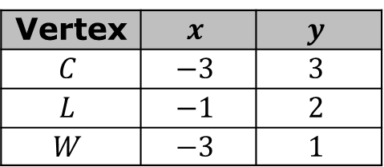
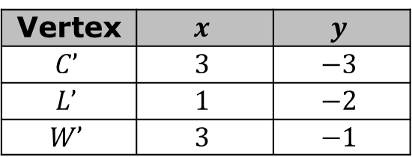

Triangles $CLW$ and $C′L′W′$ are shown on the coordinate grid. Triangle $CLW$ was rotated $180°$ about $M$to create $∆C′L′W′$.
Triangle $CLW$
Triangle $C^{′}L^{′}W′$
Vertex | $$x$$ | $$y$$
$$C$$ | $$−3$$ | $$3$$
$$L$$ | $$−1$$ | $$2$$
$$W$$ | $$−3$$ | $$1$$
Vertex | $$x$$ | $$y$$
$$C’$$ | $$3$$ | $$−3$$
$$L’$$ | $$1$$ | $$−2$$
$$W’$$ | $$3$$ | $$−1$$
volume 1, pg. 181

Slide 17
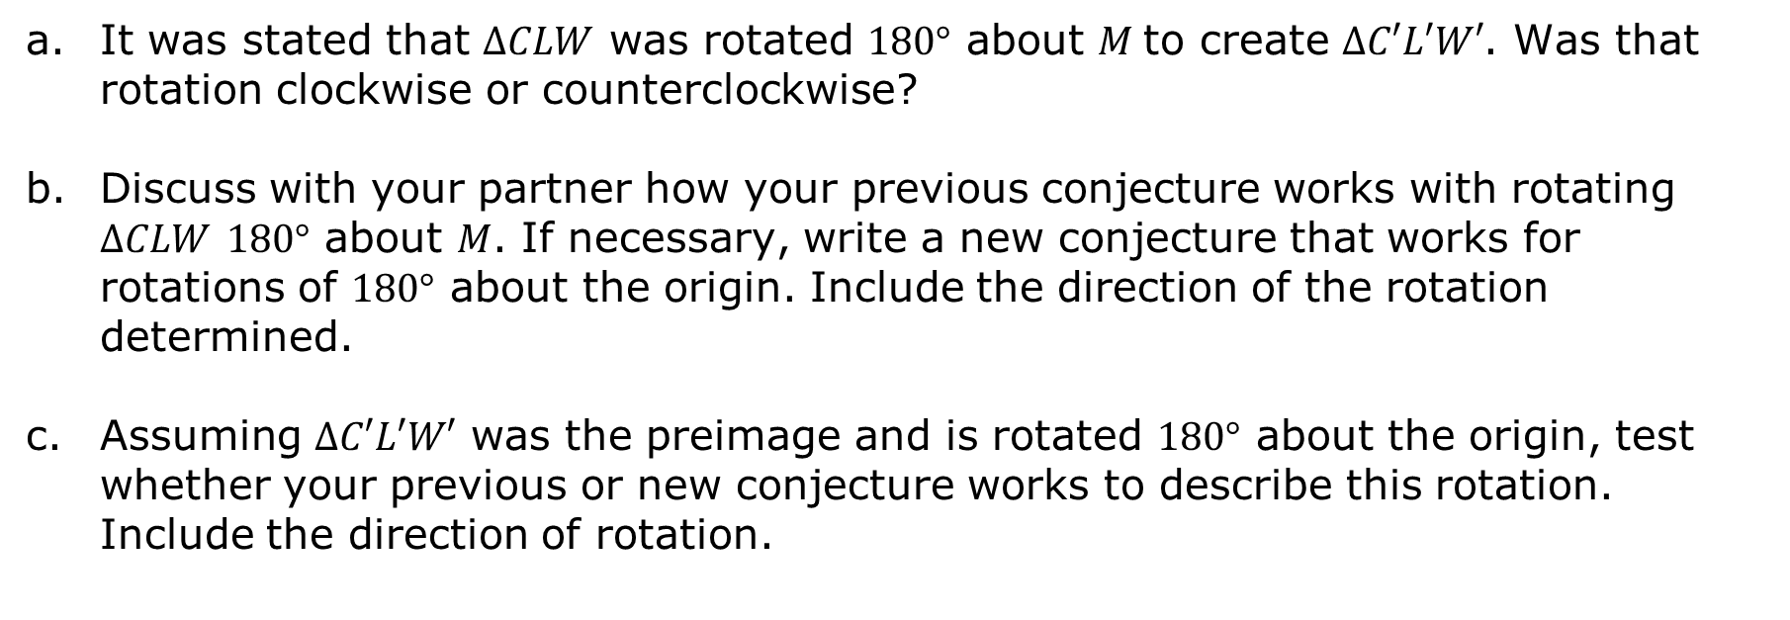
It was stated that $∆CLW$ was rotated $180°$ about $M$to create $∆C′L′W′$. Was that rotation clockwise or counterclockwise?
Discuss with your partner how your previous conjecture works with rotating $∆CLW$ $180°$ about $M$. If necessary, write a new conjecture that works for rotations of $180°$ about the origin. Include the direction of the rotation determined.
Assuming $∆C′L′W′$ was the preimage and is rotated $180°$ about the origin, test whether your previous or new conjecture works to describe this rotation. Include the direction of rotation.
volume 1, pg. 181

Slide 18
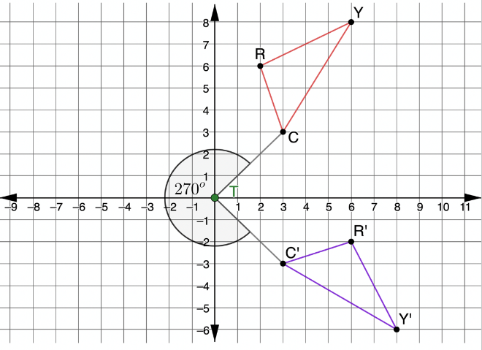

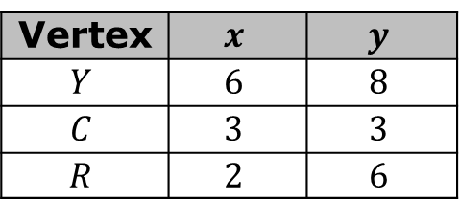
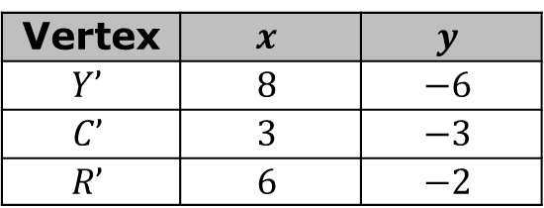

Triangles $YCR$and $Y′C′R′$ are shown on the coordinate grid. $∆YCR$ was rotated $270°$ counterclockwise about $T$to create $∆Y′C′R′$.
Triangle $YCR$
Triangle $Y^{′}C^{′}R′$
Vertex | $$x$$ | $$y$$
$$Y$$ | $$6$$ | $$8$$
$$C$$ | $$3$$ | $$3$$
$$R$$ | $$2$$ | $$6$$
Vertex | $$x$$ | $$y$$
$$Y’$$ | $$8$$ | $$−6$$
$$C’$$ | $$3$$ | $$−3$$
$$R’$$ | $$6$$ | $$−2$$
volume 1, pg. 182

Slide 19

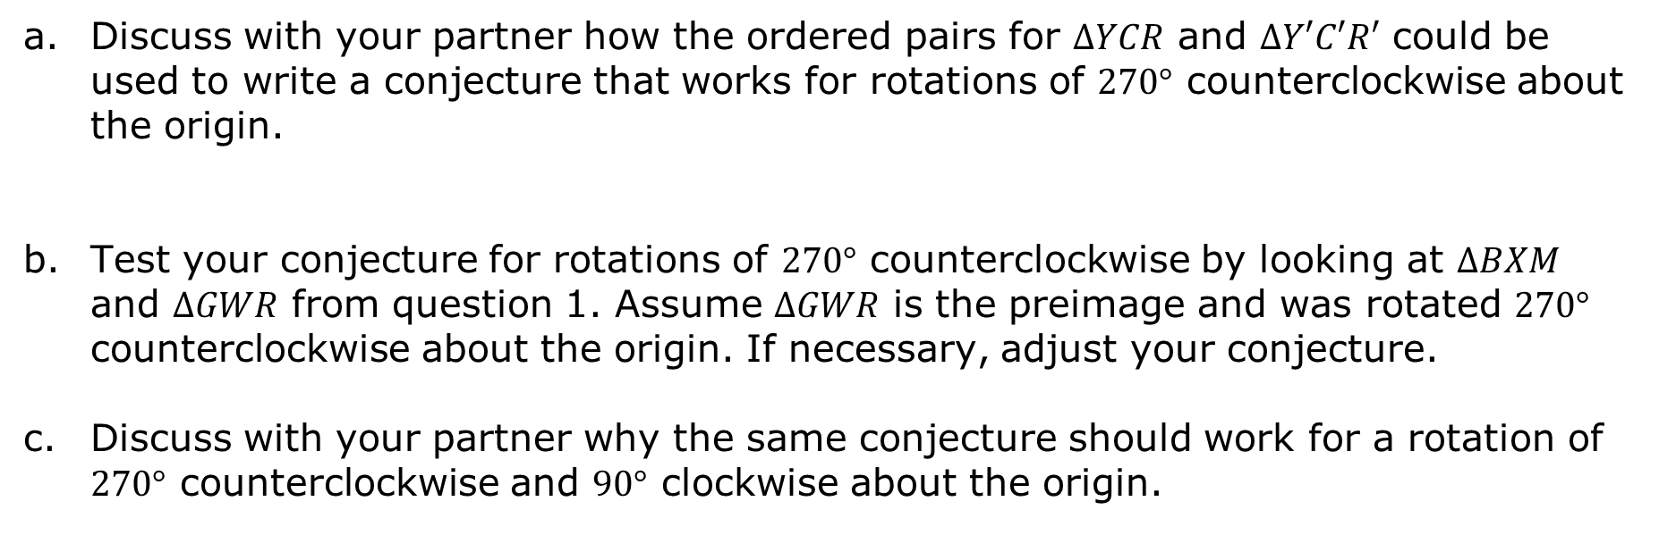
Discuss with your partner how the ordered pairs for $∆YCR$ and $∆Y′C′R′$ could be used to write a conjecture that works for rotations of $270°$ counterclockwise about the origin.
Test your conjecture for rotations of $270°$ counterclockwise by looking at $∆BXM$ and $∆GWR$ from question 1. Assume $∆GWR$ is the preimage and was rotated $270°$ counterclockwise about the origin. If necessary, adjust your conjecture.
Discuss with your partner why the same conjecture should work for a rotation of $270°$ counterclockwise and $90°$ clockwise about the origin.
volume 1, pg. 182

Slide 20

Bring It Together
volume 1, pg. 183

Slide 21

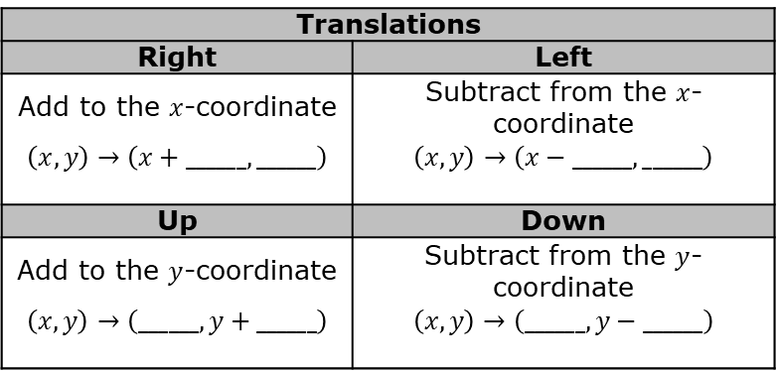
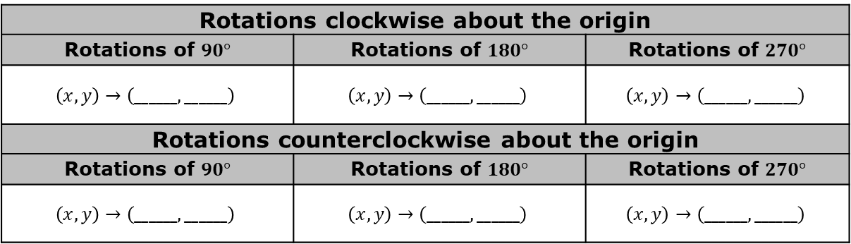
4.1.4 Bring It Together: Algebraic Descriptions for Translations and Rotations
Translations
Right | Left
Add to the $x$-coordinate | Subtract from the $x$-coordinate
$$\left(x,y\right)→\left(x+______,______\right)$$ | $$\left(x,y\right)→\left(x−______,______\right)$$
Up | Down
Add to the $y$-coordinate | Subtract from the $y$-coordinate
$$\left(x,y\right)→\left(______,y+______\right)$$ | $$\left(x,y\right)→\left(______,y−______\right)$$
Rotations clockwise about the origin
Rotations of $90°$ | Rotations of $180°$ | Rotations of $270°$
$$\left(x,y\right)→\left(______,______\right)$$ | $$\left(x,y\right)→\left(______,______\right)$$ | $$\left(x,y\right)→\left(______,______\right)$$
Rotations counterclockwise about the origin
Rotations of $90°$ | Rotations of $180°$ | Rotations of $270°$
$$\left(x,y\right)→\left(______,______\right)$$ | $$\left(x,y\right)→\left(______,______\right)$$ | $$\left(x,y\right)→\left(______,______\right)$$
What do you notice about the algebraic descriptions for rotations?
volume 1, pg. 183

Slide 22

Wrap-Up
volume 1, pg. 183

Slide 23
4.1.5 Wrap-Up: Cool Down
A student asks you for help with algebraic descriptions for rotations because they are stuck on how to do it. Describe the process using what you learned in this lesson, highlighting any potential misconceptions they may have.
volume 1, pg. 183

